Slide 1


Final Project
Robot Planning – ENPM661

Slide 2


Comparison of improvements in RRT Connect

Slide 3
RRT Connect Comparisons
RRT Connect
RRT Connect Improvement with middle node
RRT Connect with Improvement in generating the random node

Slide 4
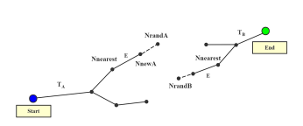
RRT Connect

Slide 5
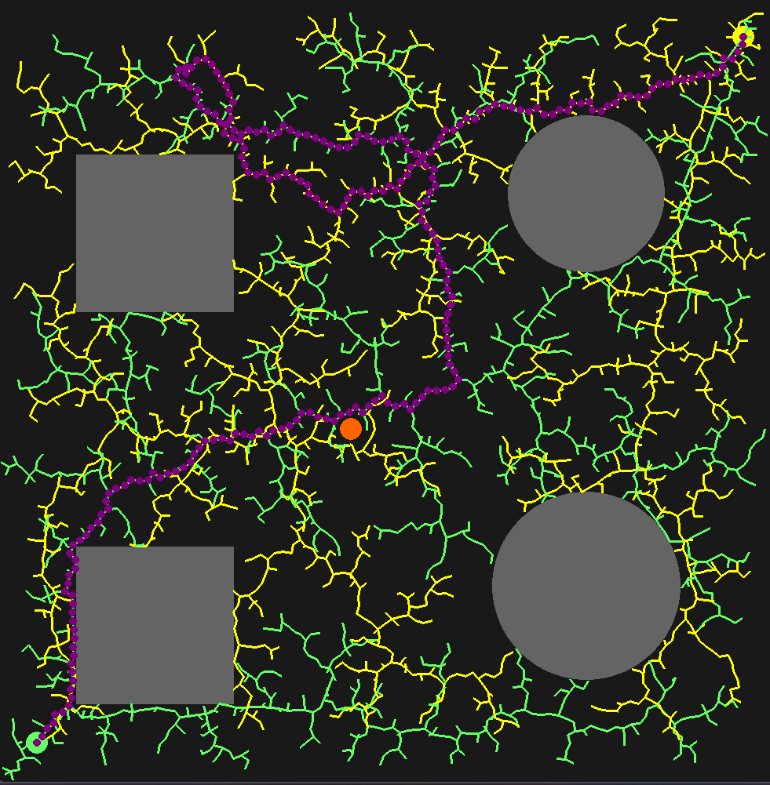
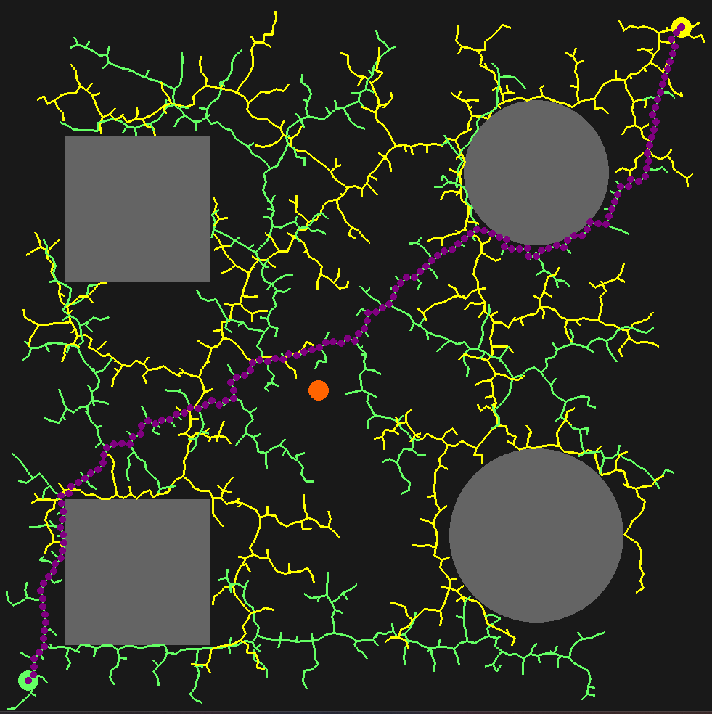
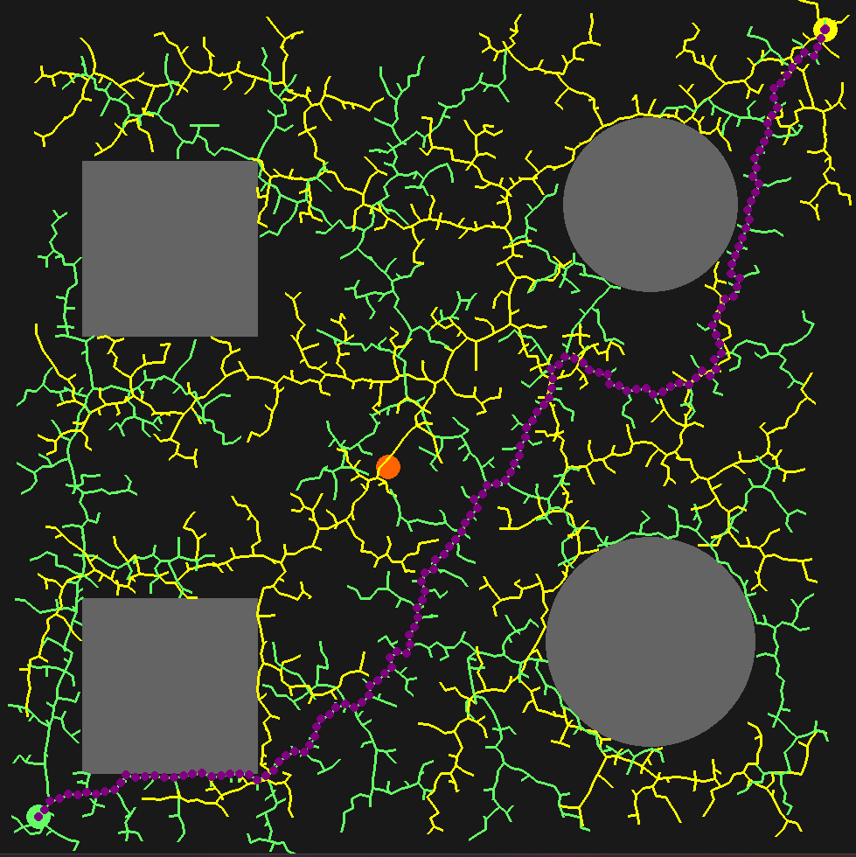
RRT Connect Results
Iteration Count = 2037
Time = 2.28 seconds
Iteration Count = 1326
Time = 1.45seconds
Iteration Count = 1833
Time = 2.13 seconds

Slide 6
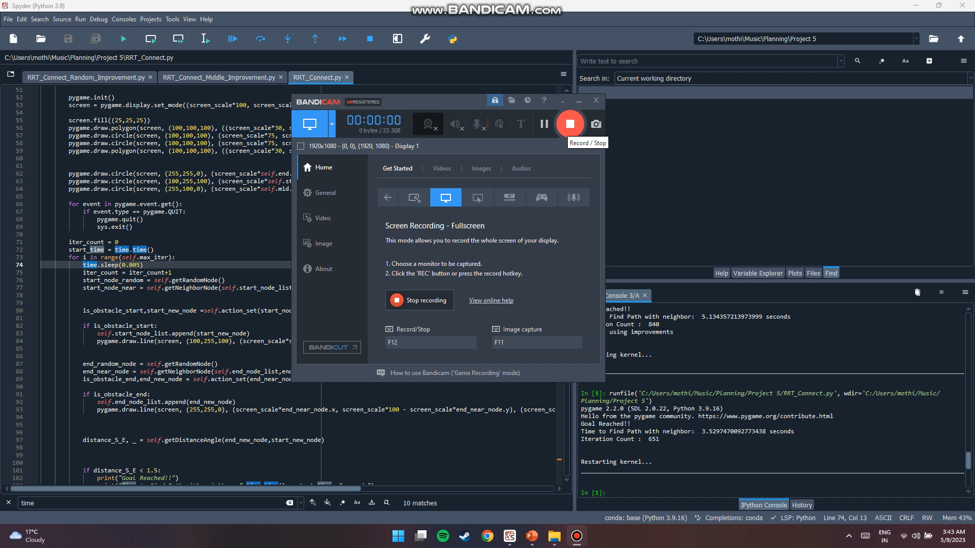

Slide 7
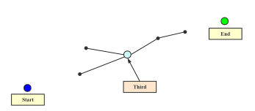
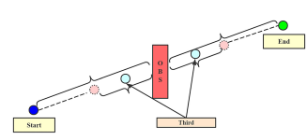
RRT Connect with middle node
For this project scope we consider the case with no obstacle in middle node.

Slide 8
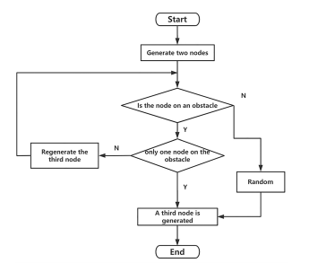
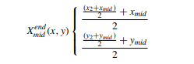
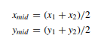
RRT Middle Algorithm

Slide 9
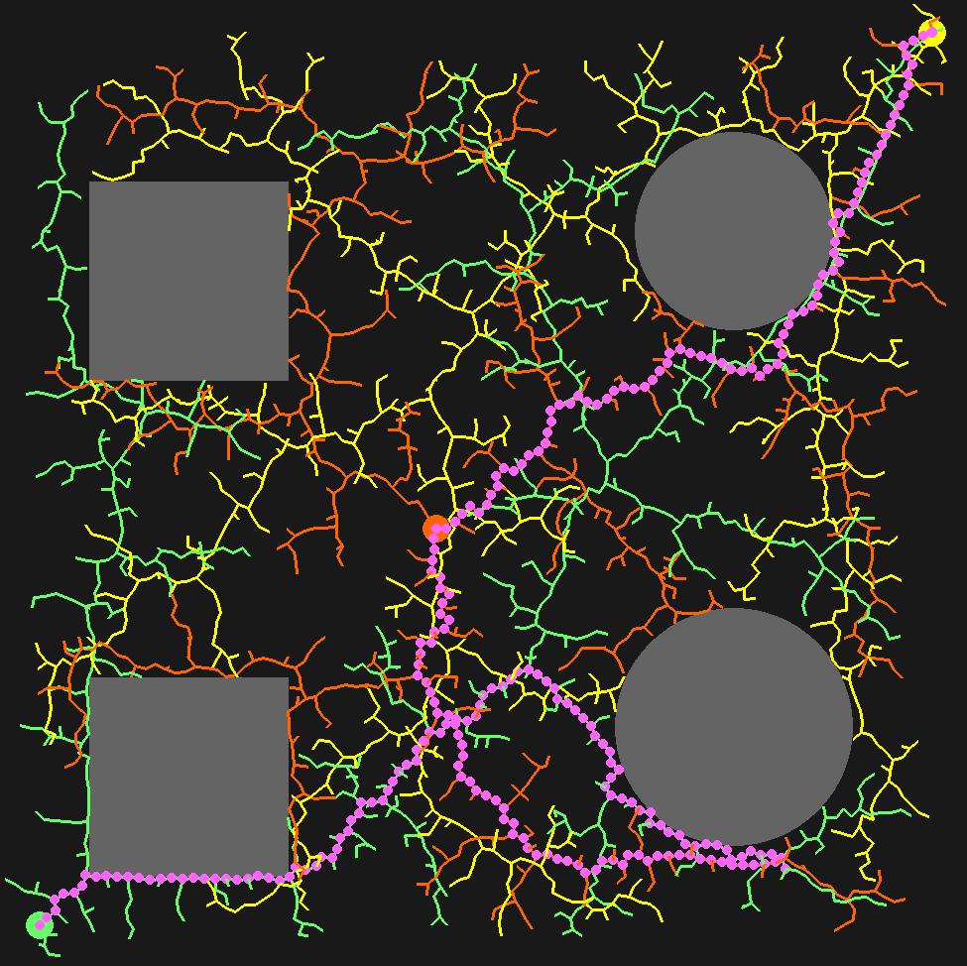
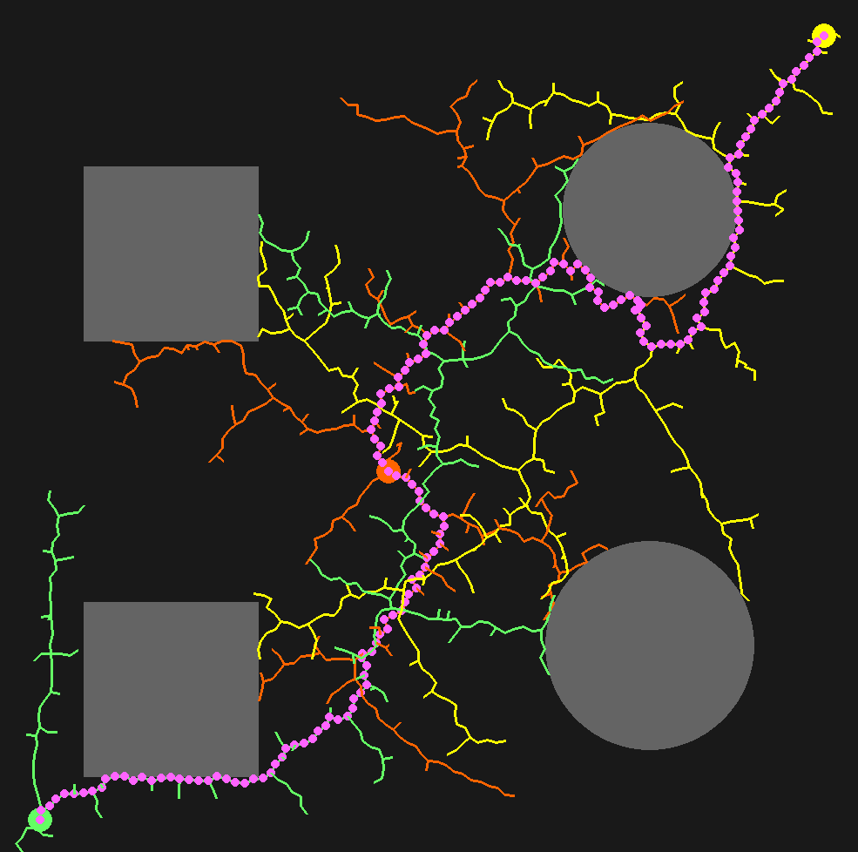
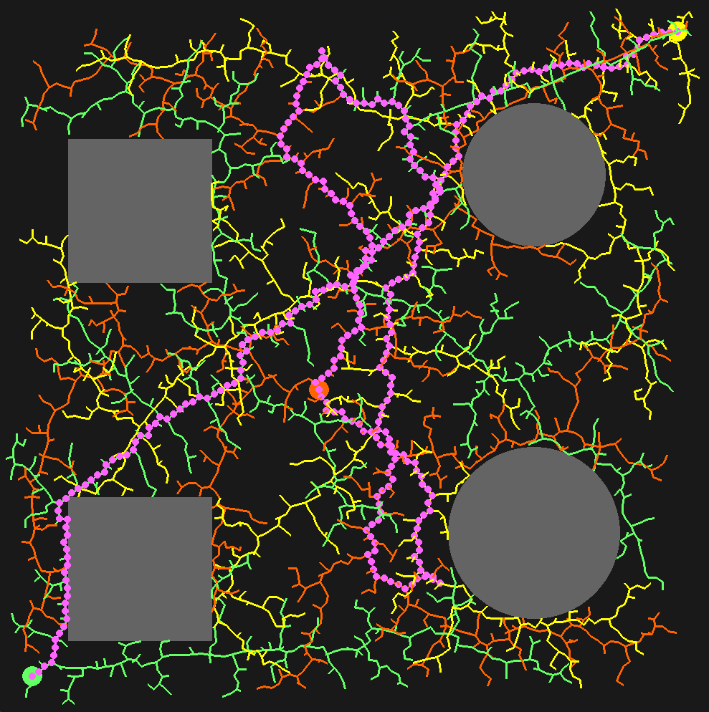
RRT Connect with middle node results
Iteration Count = 1264
Time = 1.7 seconds
Iteration Count = 533
Time = 0.84 seconds
Iteration Count = 1580
Time = 2.19 seconds

Slide 10
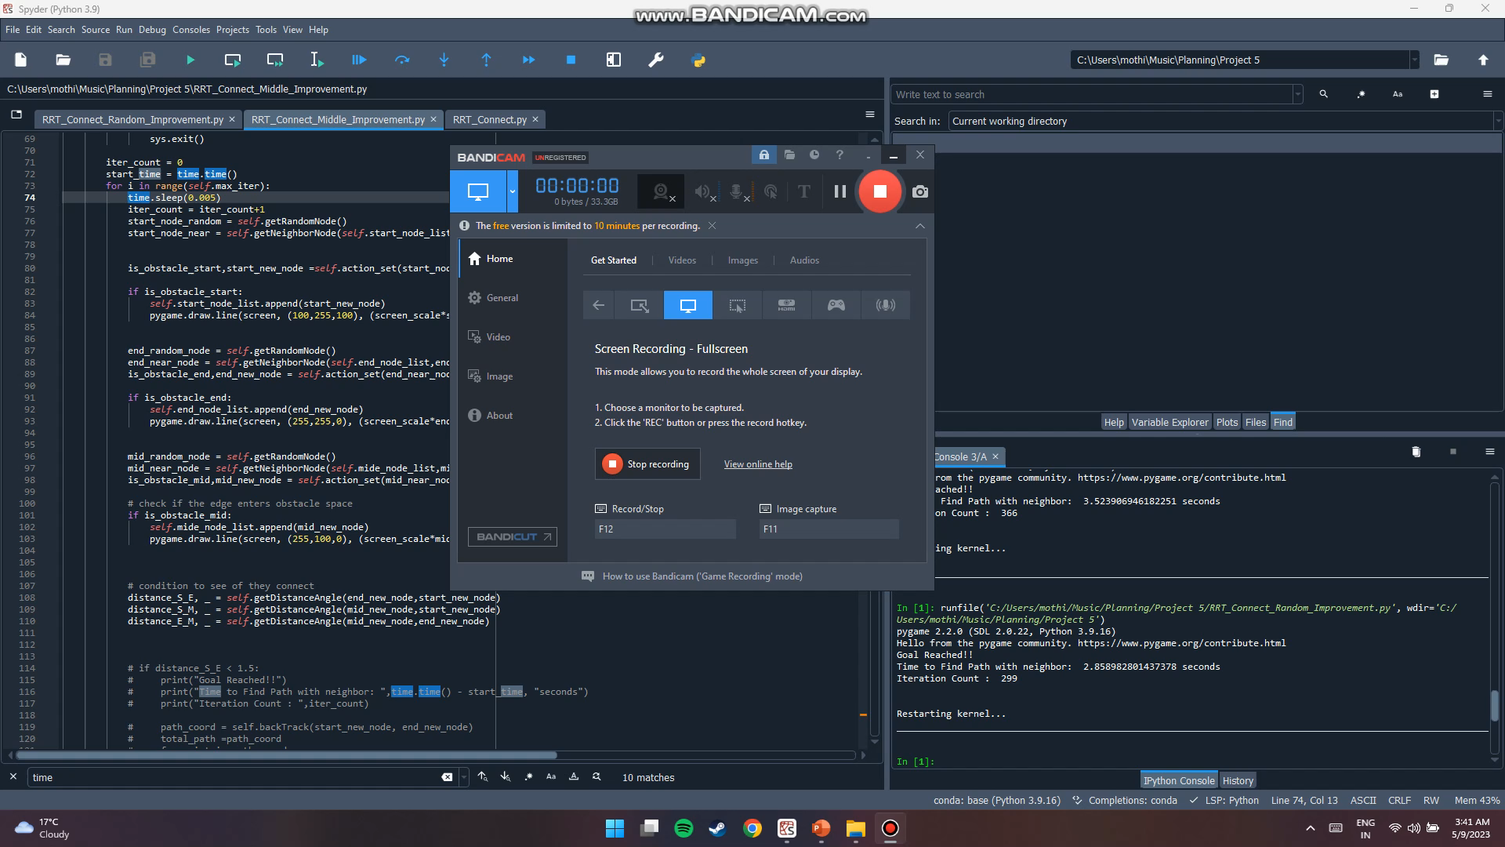

Slide 11
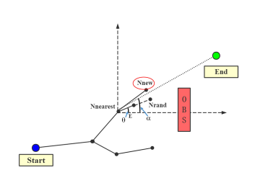
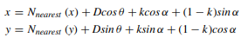
RRT Connect with Random node
D minimum value of the distance between a fixed step E and N-nearest and N-rand
K constant
α angle is the angle between the end point X-end and N-nearest
ϴ angle is the angle enclosed by the sampling point N-rand and the nearest point N-nearest
on the tree in the horizontal axis direction

Slide 12
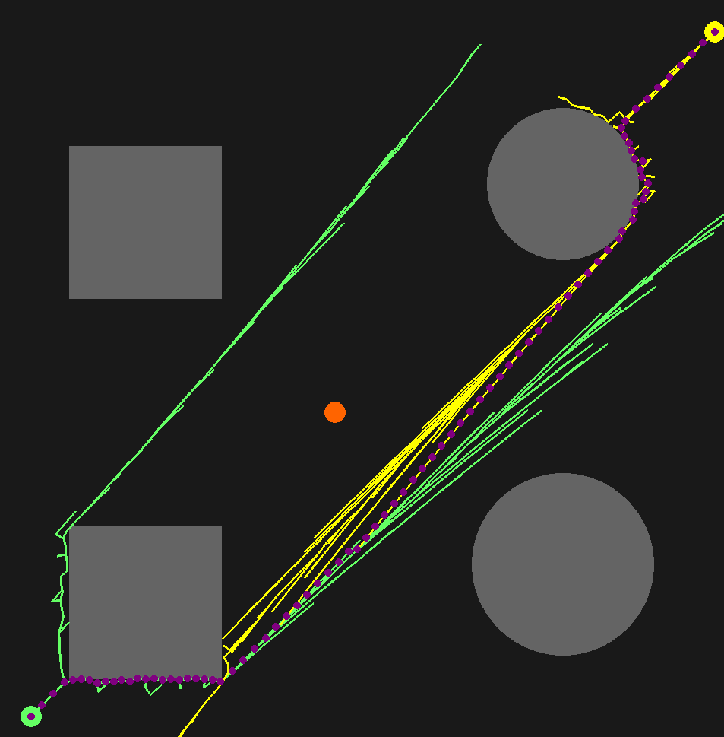
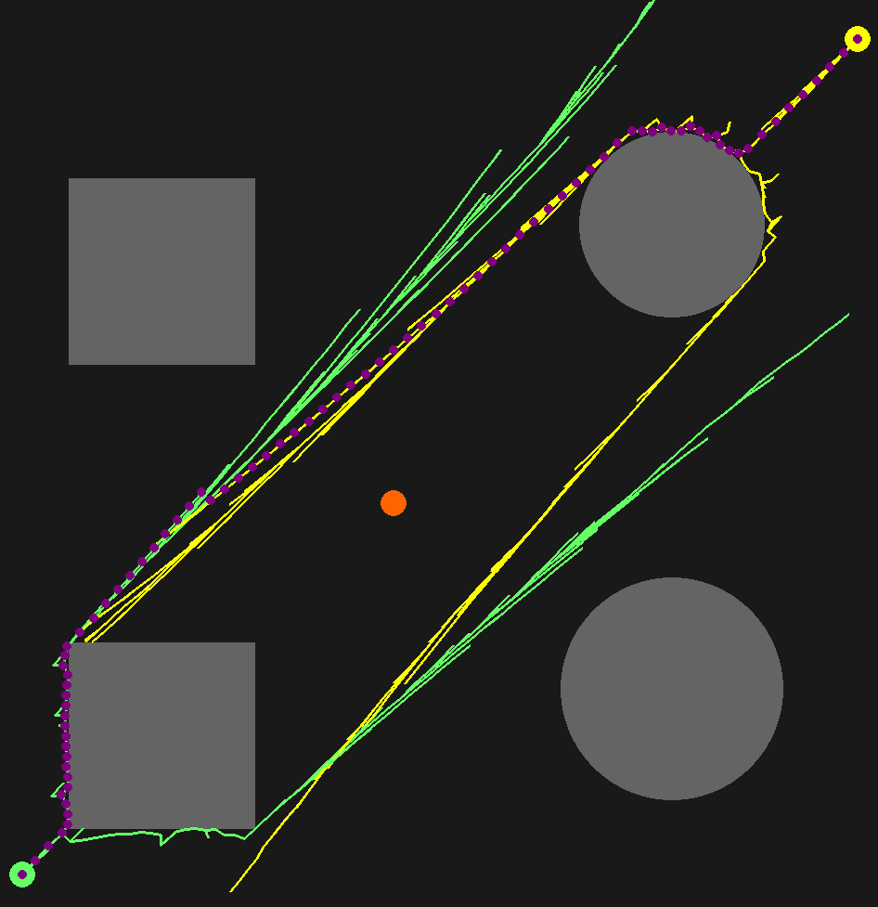
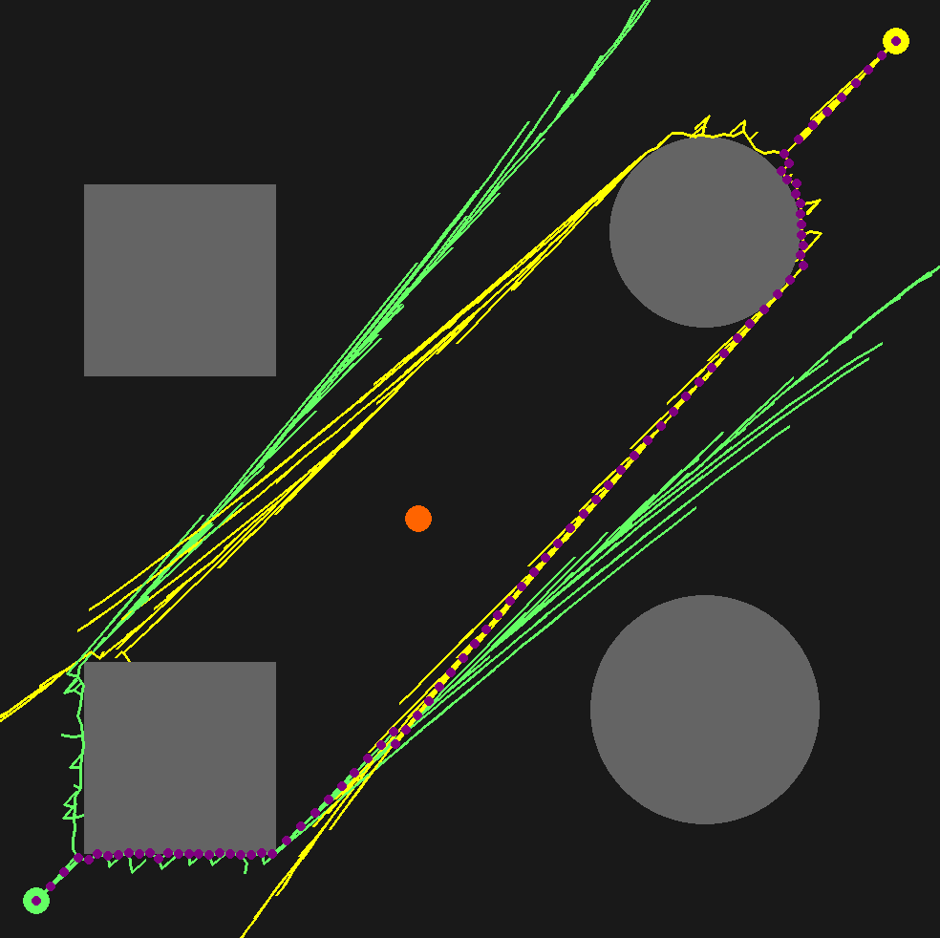
RRT Improvement random node results
Iteration Count = 771
Time = 0.91 seconds
Iteration Count = 776
Time = 0.91 seconds
Iteration Count = 1418
Time = 1.5 seconds

Slide 13
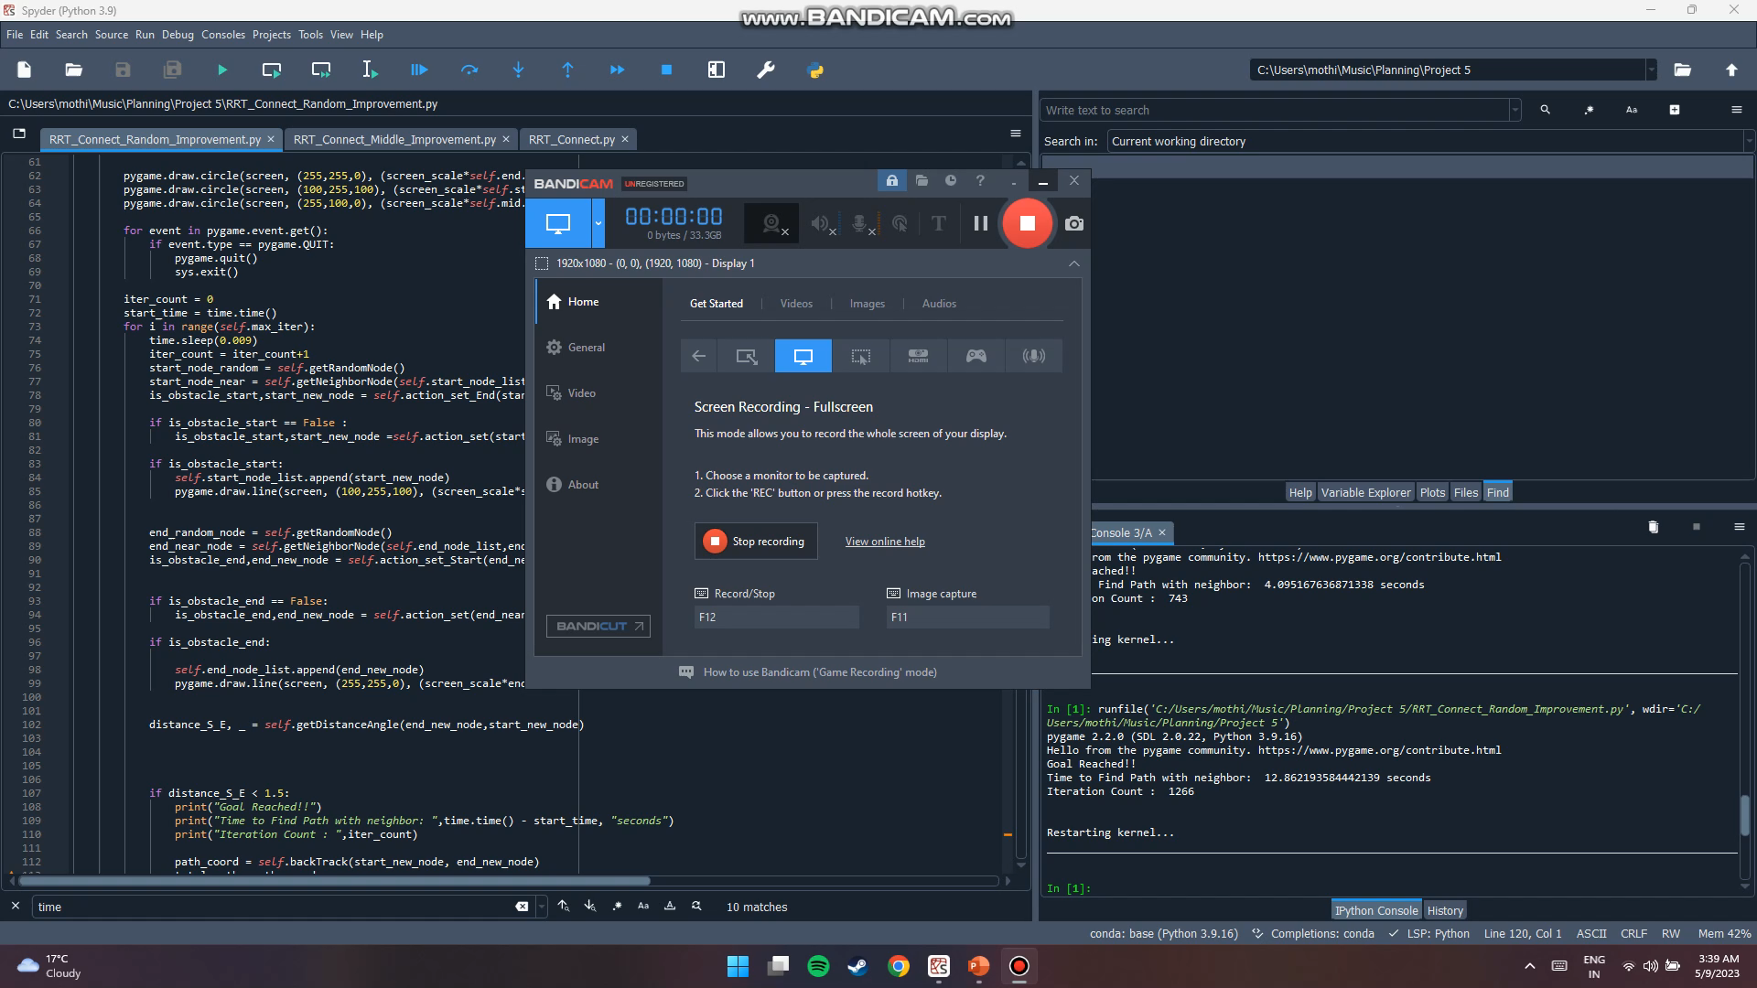

Slide 14
Conclusion
RRT Connect < RRT Mid Point < RRT Random Node

Slide 15
Thank You

